Slide 1

MAZE RUNNERS
COMP 8700 Introduction to AI
Lavanya Nagaraju: 110122643
Rumman Ali: 110119198
Arsalan Hameed: 110120861
Sai Ganesh Grandhi: 110119671

Slide 2
Contents
Introduction
Problem Statement
Background study
Literature review
Implementation & results
Conclusion
References
Demo

Slide 3
Introduction
Artificial Intelligence, refers to the development of computer systems that can perform tasks that typically require human intelligence.
Learning, reasoning, problem-solving, understanding natural language, speech recognition, and visual perception.
The goal of AI is to create machines that can mimic cognitive functions associated with human minds.
One of the classic problems in robotics and artificial intelligence is maze solving.
The aim is to navigate through a maze and discover a path that leads from the starting point to the destination while avoiding obstacles.

Slide 4

Problem statement
Focuses mainly on solving a maze problem where the agent tries to find the shortest path out of the maze, using the A* search algorithm.
While finding the path, the agent has to collect rewards with different values.
A comparative study is performed between A* search, DFS and BFS on the maze problem to find the shortest path.

Slide 5
Common Approaches to solve the Maze Problem include:
Depth-First Search (DFS)
Breadth-First Search (BFS)
Dijkstra's Algorithm
A * Search Algorithm
Q-Learning

Slide 6
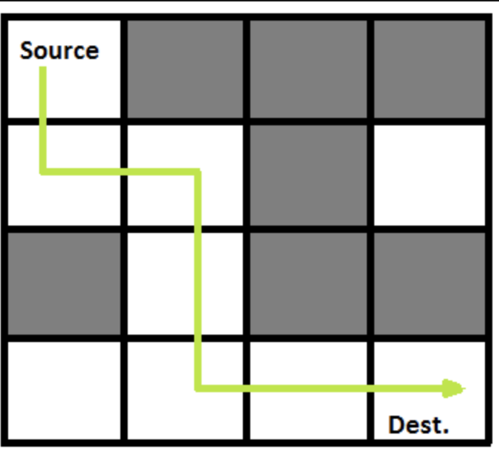
Maze is a puzzled technique explored by the solver using the most efficient route at the shortest possible time.

Slide 7
Literature review
Name of the paper:
Pathfinding in Strategy Games and Maze Solving Using A* Search Algorithm [1]
Summary:
Finding the quickest route between a source and a destination while avoiding obstacles requires pathfinding, where the A* search algorithm is utilized.
They test the system's functionality using graphic representations of mazes or maps. For every map and maze, a set of 100 photos is used for assessment.
The system's overall performance is considered satisfactory, as the A* algorithm can reliably determine the shortest path between chosen locations on the pictures.

Slide 8
Name of the paper:
Intelligent Maze Solving Robot Based on Image Processing and Graph Theory Algorithms [2]
Summary:
An artificial intelligence algorithm and image processing are used to power the robot's pathfinding.
A combination of graph theory techniques and Visual C++ and OpenCV packages are used to process the camera-captured image of the maze.
The robot, which resembles a car, then receives instructions via Bluetooth that direct it in the best direction.
This method outperforms the conventional ones because it does not require the robot to navigate the maze cell by cell, which leads to faster navigation.

Slide 9
Name of the paper:
A comprehensive and comparative study of DFS, BFS, and A* search algorithms in a solving the maze transversal problem [3]
Summary:
In the Maze transversal problem, pathfinding algorithms, Depth first Search (DFS), Breadth First Search (BFS) and A star (A*) were used for the comparison.
The comparison procedure was carried out by running the different algorithms in three (3) mazes with the same dimensions but different obstacles and monitoring the execution time and path length.
The findings of this study suggest that the A* search algorithm should be used in the Maze transversal problem as it finds the shortest path to the goal in the shortest possible time and length.

Slide 10



Implementation
Programming languages - C++ and Java
Libraries – Java Standard Edition Library
Maze Runner has been developed to incorporate A*, DFS, and BFS algorithms, accompanied by a comprehensive analysis and comparison of their performances.
Maze Runner is structured with the objective for the agent to navigate from the starting point to the endpoint, while collecting rewards along its journey.
Gold, Kohinoor and stones are the rewards having different values, and agent should collect all of them before it reaches end point.
Algorithm's performance is measured using total step count and node expanded count.

Slide 11

Results
 | DFS | BFS | A*
Total steps | 1406 | 144 | 142
Total expanded nodes | 6060 | 1756 | 162
The experiment is conducted on a same maze for all three algorithms to compare algorithm's performance.
The results show that A* performed well in comparison and that is due to its heuristic properties.

Slide 12
Conclusion
In maze runner, one can employ DFS, BFS and A* algorithms to find the shortest path towards the goal.
The Depth first search is proven not to be an effective path finding algorithm since it takes long time to discover the path to destination.
While solving the maze problem, the A* proved to be the best path finding method. This can be proven by the fact that the total steps and expanded nodes is least to find the goal state.
The informed search is faster and more likely to discover the best solution than the Uninformed search.

Slide 13
References
[1] Barnouti, N. , Al-Dabbagh, S. and Sahib Naser, M. (2016) Pathfinding in Strategy Games and Maze Solving Using A* Search Algorithm. Journal of Computer and Communications, 4, 15-25. doi: 10.4236/jcc.2016.411002.
[2] M. O. A. Aqel, A. Issa, M. Khdair, M. ElHabbash, M. AbuBaker and M. Massoud, "Intelligent Maze Solving Robot Based on Image Processing and Graph Theory Algorithms," 2017 International Conference on Promising Electronic Technologies (ICPET), Deir El-Balah, Palestine, 2017, pp. 48-53, doi: 10.1109/ICPET.2017.15.
[3] Sadik, Adil & Dhali, Maruf A & Farid, Hasib & Rashid, Tafhim & Syed, Anas. (2010). A Comprehensive and Comparative Study of Maze-Solving Techniques by Implementing Graph Theory. 52 - 56. 10.1109/AICI.2010.18.

Slide 14
Q & A

Slide 15
THANK YOU

